Slide 1
Climate Change and Biodiversity

Slide 2

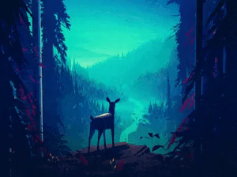

Slide 3
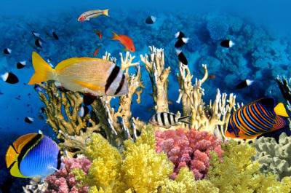
Biodiversity is the sum of all living organisms - plants, animals and micro-organisms - and all their genetic variation within complex ecosystems.
Biodiversity can be found everywhere: lakes, forests, oceans, mountains, deserts, housing, parks, to give a few examples. It can even be found on our skin and within internal organs!

Slide 4
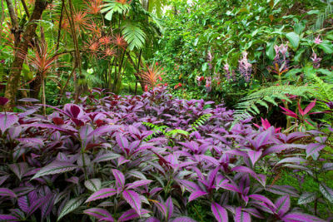
Biodiversity can be broken down into three main forms:
Ecosystem diversity
Species diversity
Genetic diversity

Slide 5
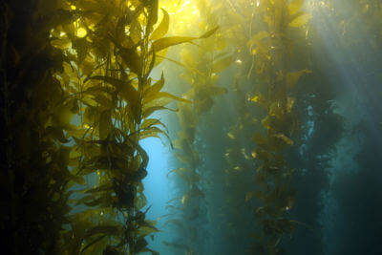
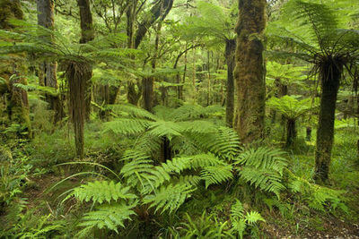
Ecosystem diversity is the range of ecosystems found throughout the biosphere.
This range covers very different ecosystems (underwater, jungle, desert), as well as very similar ecosystems (jungle floor, jungle treetops).

Slide 6
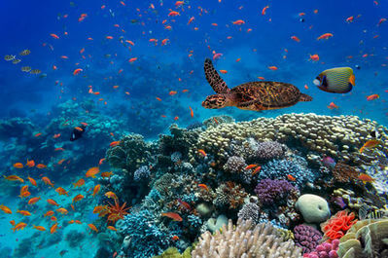
Species diversity is the number of different species within an ecosystem.
The more species diversity an ecosystem has, the lower the impact of losing a species.

Slide 7

Genetic diversity is the range of genetic characteristics within a single species.
The more genetic diversity a species has, the more likely it is to survive a change to the ecosystem.

Slide 8
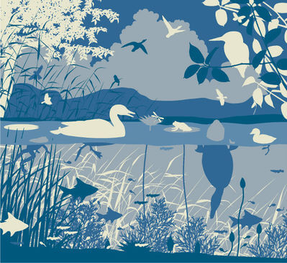
A high genetic diversity helps a species survive changes to the environment.
A high species diversity helps an ecosystem survive changes to the environment.
A high ecosystem diversity helps the biosphere survive changes to the environment.

Slide 9
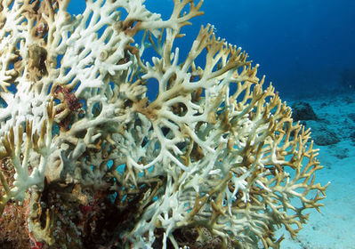
In general, the more biodiversity in the biosphere, the more stable the biosphere will be.
If the biosphere loses biodiversity, it becomes possible for entire ecosystems to collapse.
Some ecosystems are dependent on coral reefs, so as the reefs die the ecosystem dies with them.

Slide 10
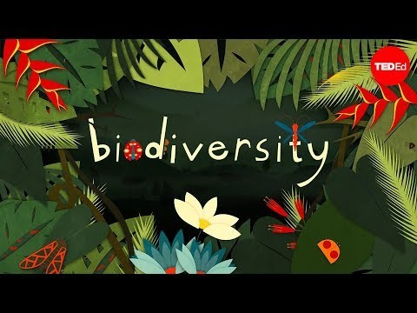

Slide 11
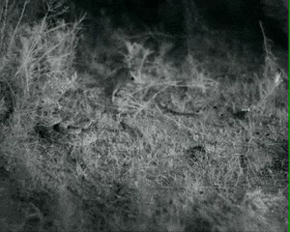
So what is the link between climate change and biodiversity?
Aspects of climate change like the greenhouse effect and global warming alter the environment and surrounding ecosystems. Any changes in an ecosystem can be detrimental to a species' survival.
For example, if a food source is removed from an ecosystem it can effect the survival of other species in the food web!

Slide 12
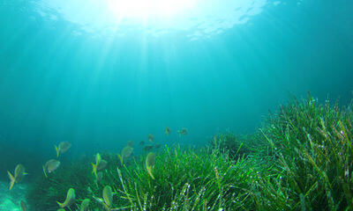
Sea meadows contain entire ecosystems based around plants known as seagrasses.
The seagrasses provide food and habitats for a diverse range of marine species, however, the diversity of seagrasses is limited. There are usually only one or two dominant seagrass species in a particular ecosystem.

Slide 13
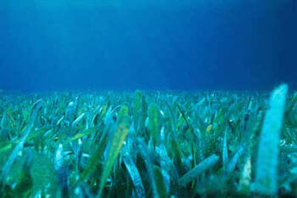
Climate change can damage seagrass meadows in a number of ways:
1. | Seagrasses are very durable, however, the increasing number and severity of storms is beginning to damage seagrass meadows.
2. | Storms increase the turbidity, or cloudiness, of the water. Seagrasses need clear oceans in order to photosynthesise.
3. | Decaying seagrasses can cause algal blooms, or sudden algae growths, which further increases turbidity.

Slide 14
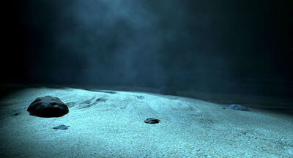
Sea meadows are at risk of extinction if the effects of climate change continue or worsen.
If this were to happen, all of the species dependent on the meadows would also die out. This means that the extinction of seagrass would lead to the collapse of an entire ecosystem.

Slide 15
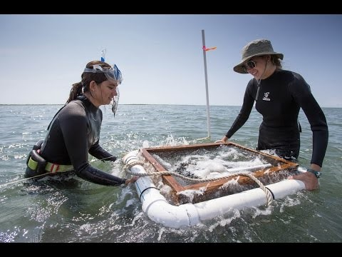

Slide 16
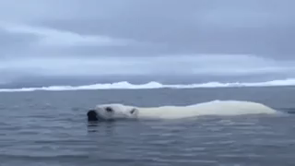
As the global temperatures rises, polar ice caps are melting and leading to a rise in global sea levels.
Consequently, low lying cities and land, such as that of the Maldives (in the Indian Ocean), are at an increased risk of flooding. A significant rise in sea levels will lead to the destruction of habitats.

Slide 17
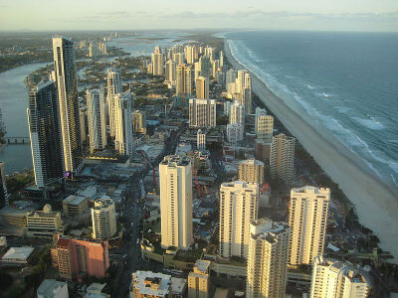
In the past, whenever sea levels rose, animals and humans could just move inland until the levels went down again.
Nowadays, a huge amount of our infrastructure is found in coastal cities that cannot be easily moved inland. If sea levels were to rise, the cost to recover would be massive.

Slide 18
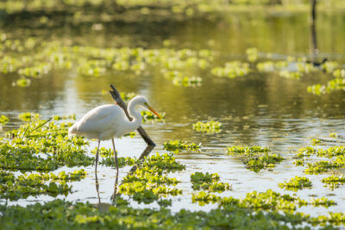
Many wetlands, swamps and marshes are very low lying. If salt water was to flood into these areas, the existing ecosystems would be drastically altered.
Species that cannot adapt to salt water would die out, and salt water species would flourish.

Slide 19
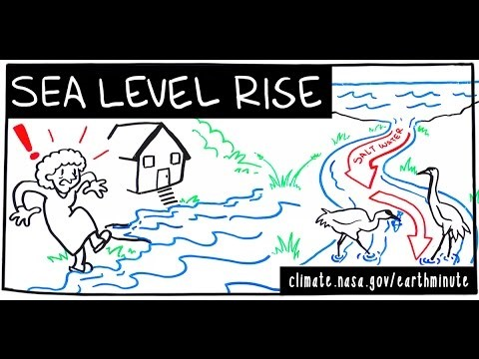

Slide 20
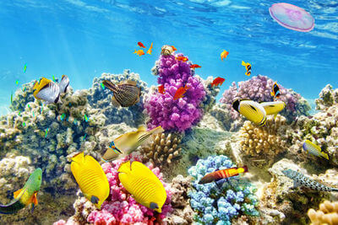
Similar to sea meadows, coral reefs contain ecosystems which are dependent on the survival of the coral.
Corals are kept healthy by a type of protist, which are tiny, single-celled organisms. The protists live inside the coral and provide nutrition, as well as a distinctive colour.

Slide 21
When coral is stressed, it will expel the protists. A temperature increase as low as 1∘C ​above average is enough to cause stress.
Once the protists are expelled, the coral will lose its colour and become bleached.
Sometimes coral can recover from bleaching, sometimes it cannot.

Slide 22
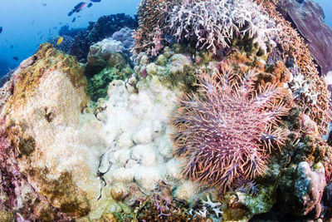
If a coral reef remains bleached, the wide range of marine life that depends on it will die. This means that, sometimes, even a 1∘C average temperature increase can lead to the destruction of an entire ecosystem.

Slide 23
